Slide 1
Cooking with AWS and Splunk
Module 6 : CloudFormation Templates
Kam Amir | Splunk Cloud Architect

Slide 2
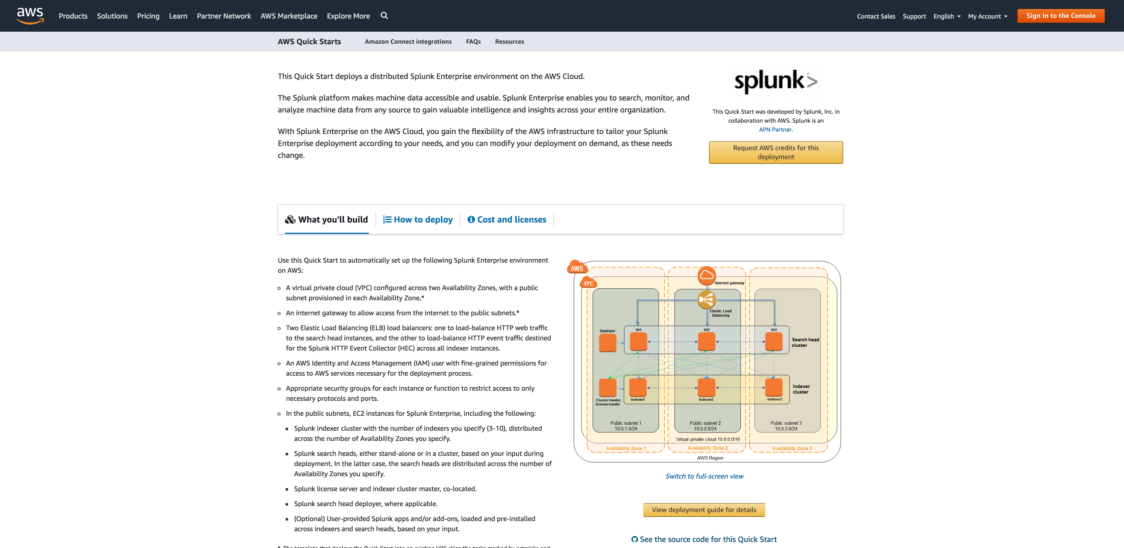
Splunk Quick Start on AWS
https://aws.amazon.com/quickstart/architecture/splunk-enterprise/

Slide 3
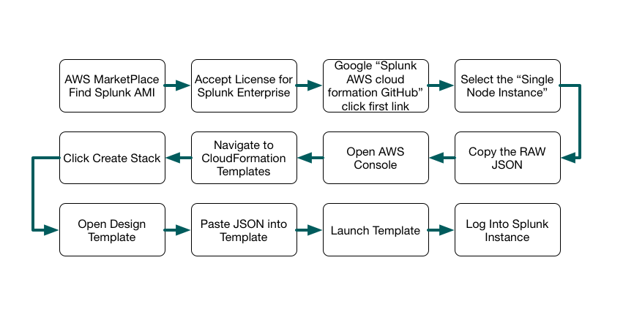
CloudFormation Workflow
Workflow for using CF Templates and Splunk

Slide 4
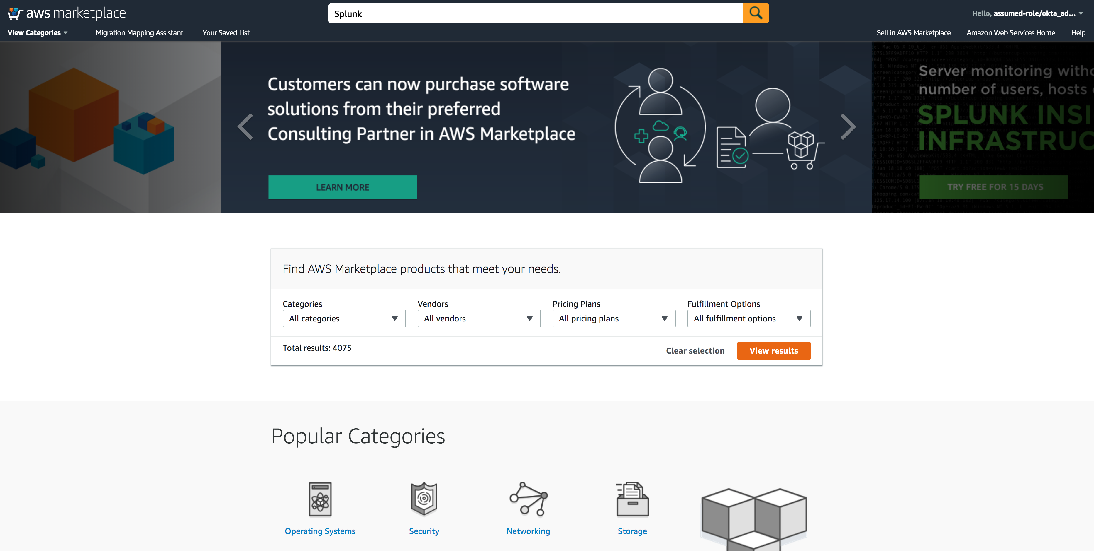
Go to AWS Market Place
Go to https://aws.amazon.com/marketplace, search for Splunk

Slide 5
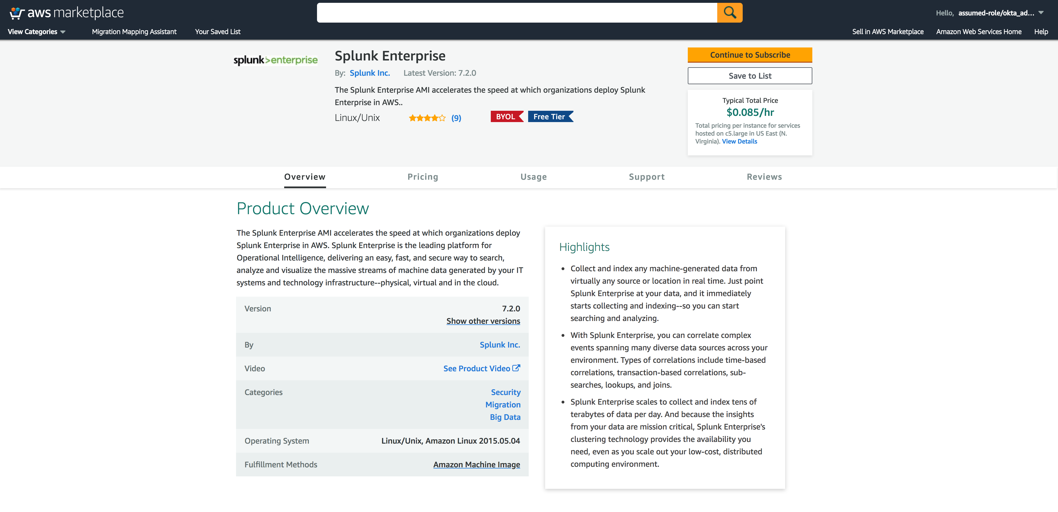
Find Splunk Enterprise
Click Continue (Sign Into AWS)
Click Here

Slide 6
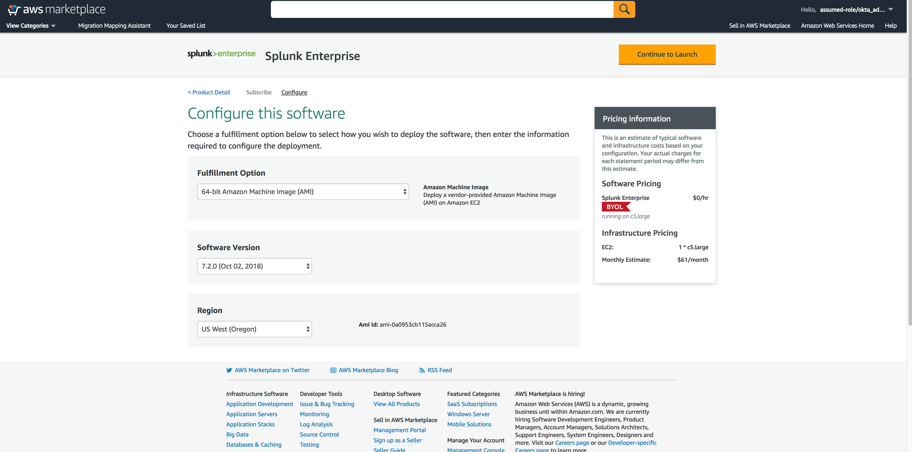
Find Splunk Enterprise
Click Continue (Sign Into AWS)
Click Here

Slide 7
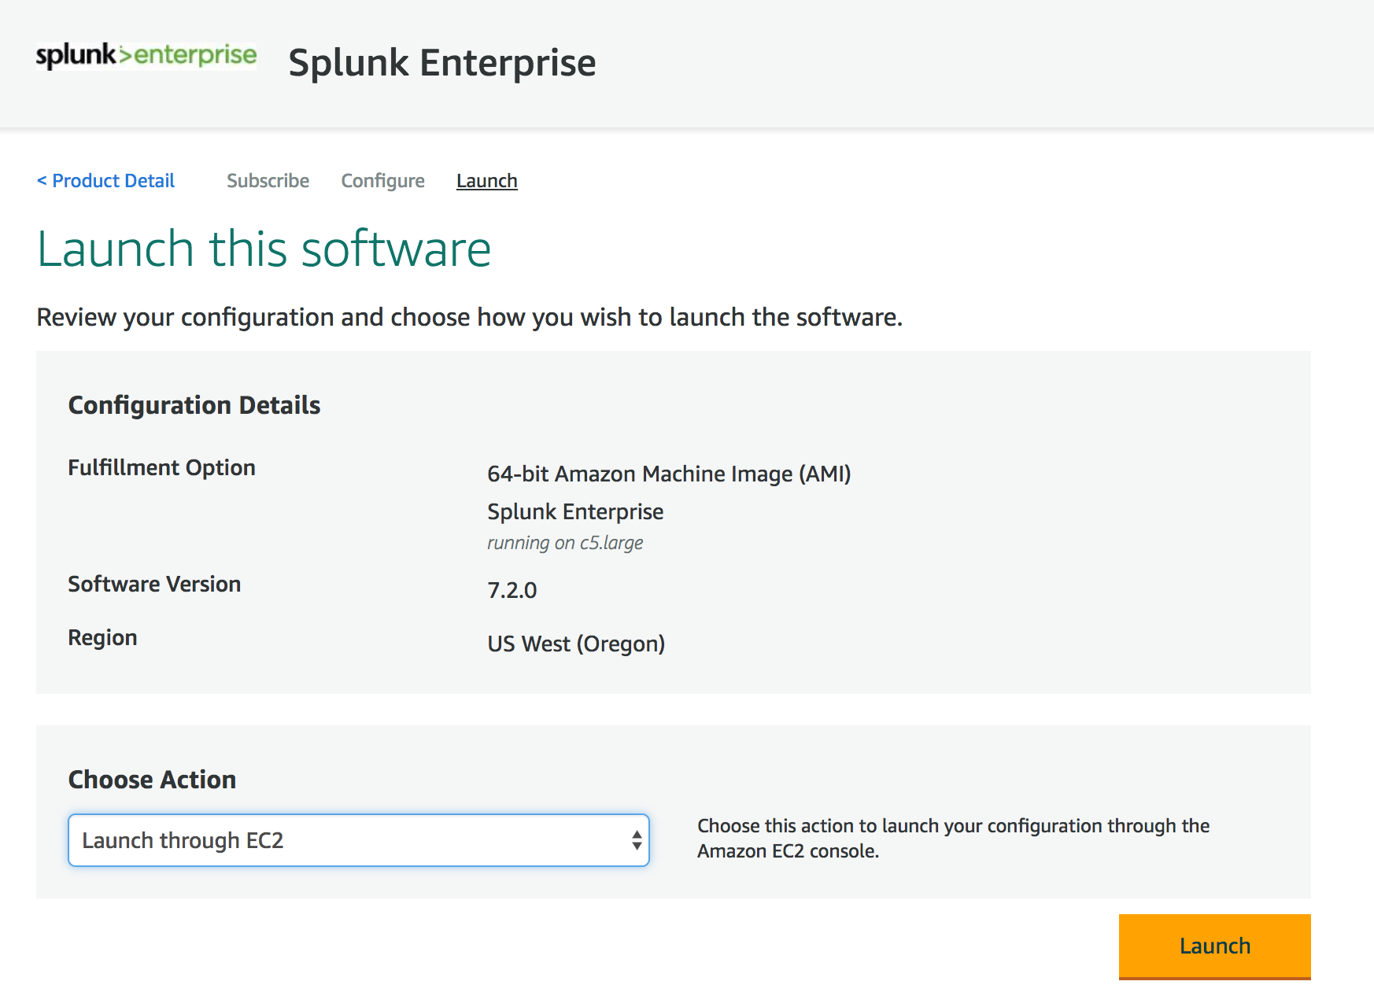
Launch Splunk Enterprise
Choose:
Launch through EC2
Click Here

Slide 8
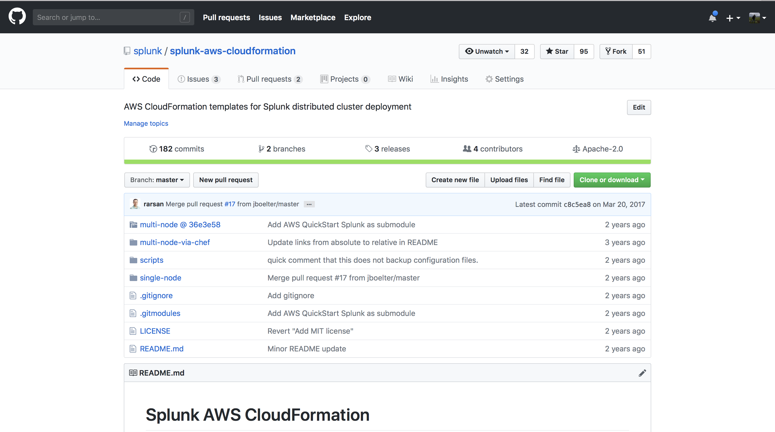
Where to Find Splunk on GitHub
https://github.com/splunk/splunk-aws-cloudformation

Slide 9
CloudFormation Deploy
CloudFormation Build Process
Download Single-Node Instance Template - https://github.com/splunk/splunk-aws-cloudformation
Open CloudFormation Upload Template
Accept License for Splunk AMI via AWS Market Place
Install Dependency for AWS App:
Splunk ML Toolkit : https://splunkbase.splunk.com/app/2890/
Python for Scientific Computing (for Linux 64 bit) : https://splunkbase.splunk.com/app/2882/
Setup AWS Inputs

Slide 10
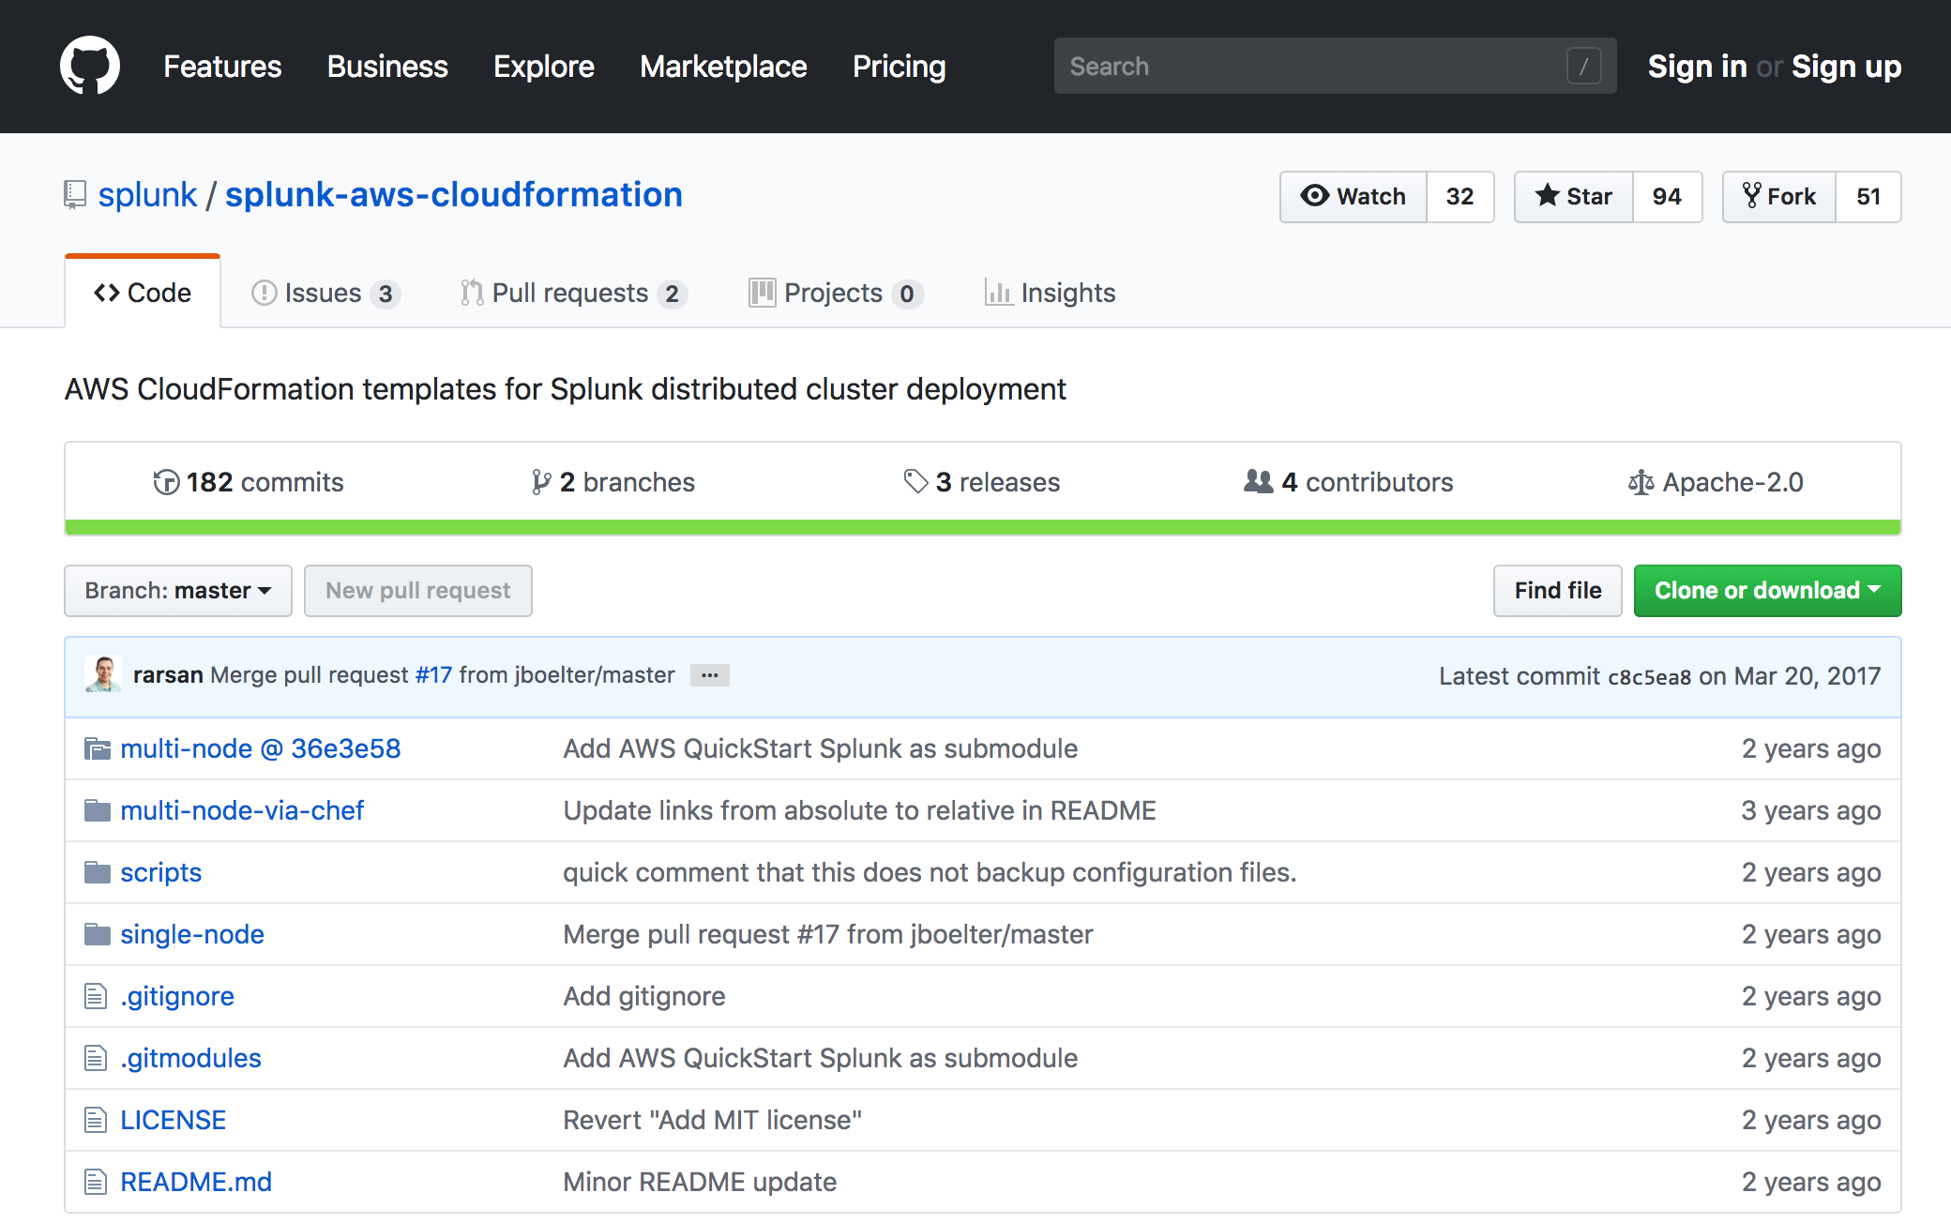
Enter GitHub to get templates
Select multi-node or single instance deployment
Multi-node
Multi-node
w/Chef
Single-Instance

Slide 11
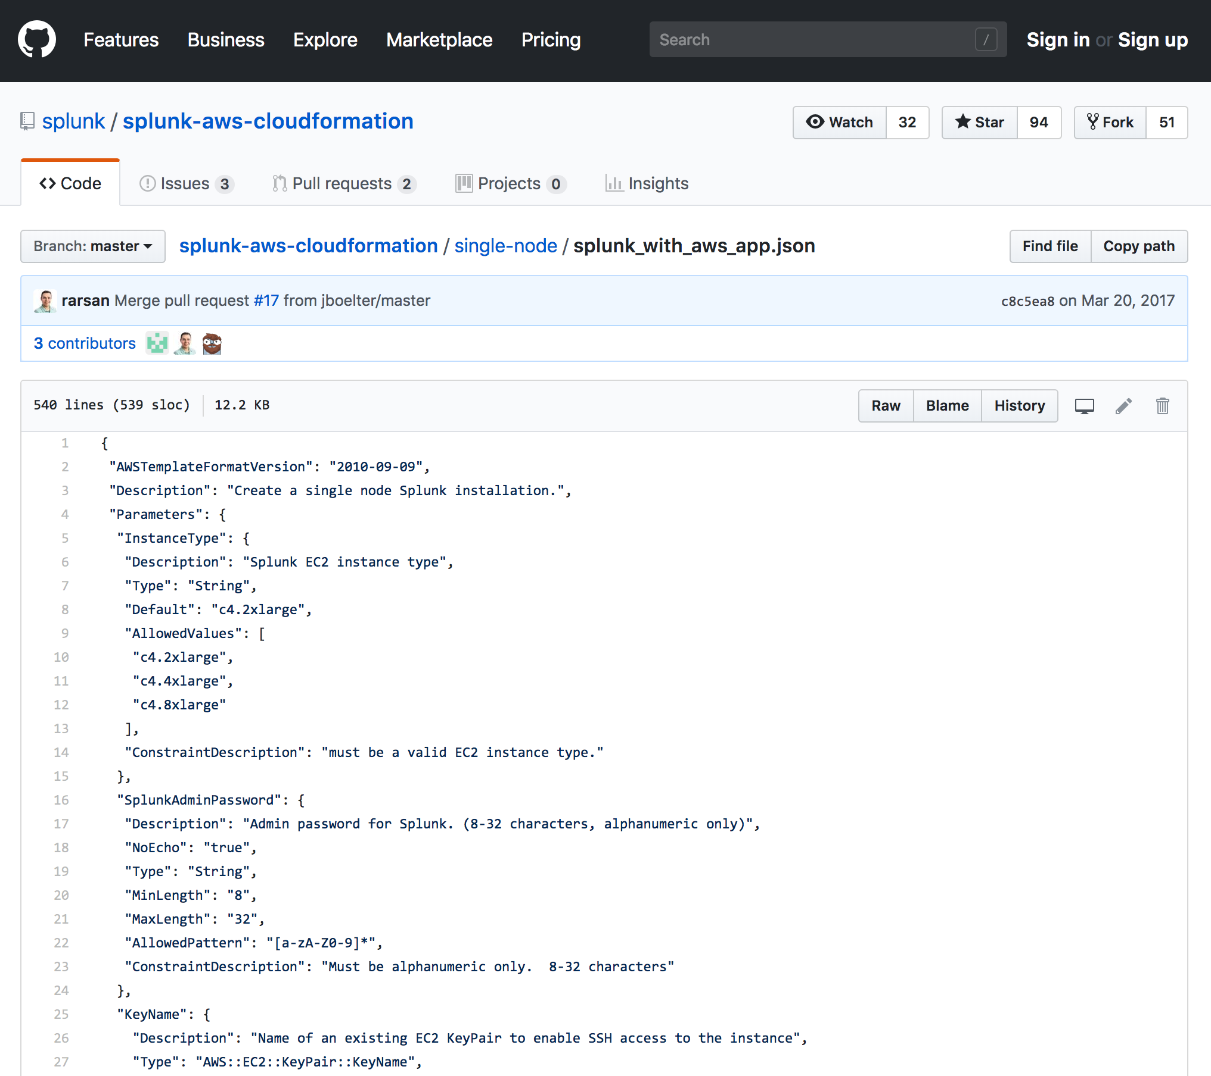
Select RAW JSON from GitHub
Click Here

Slide 12
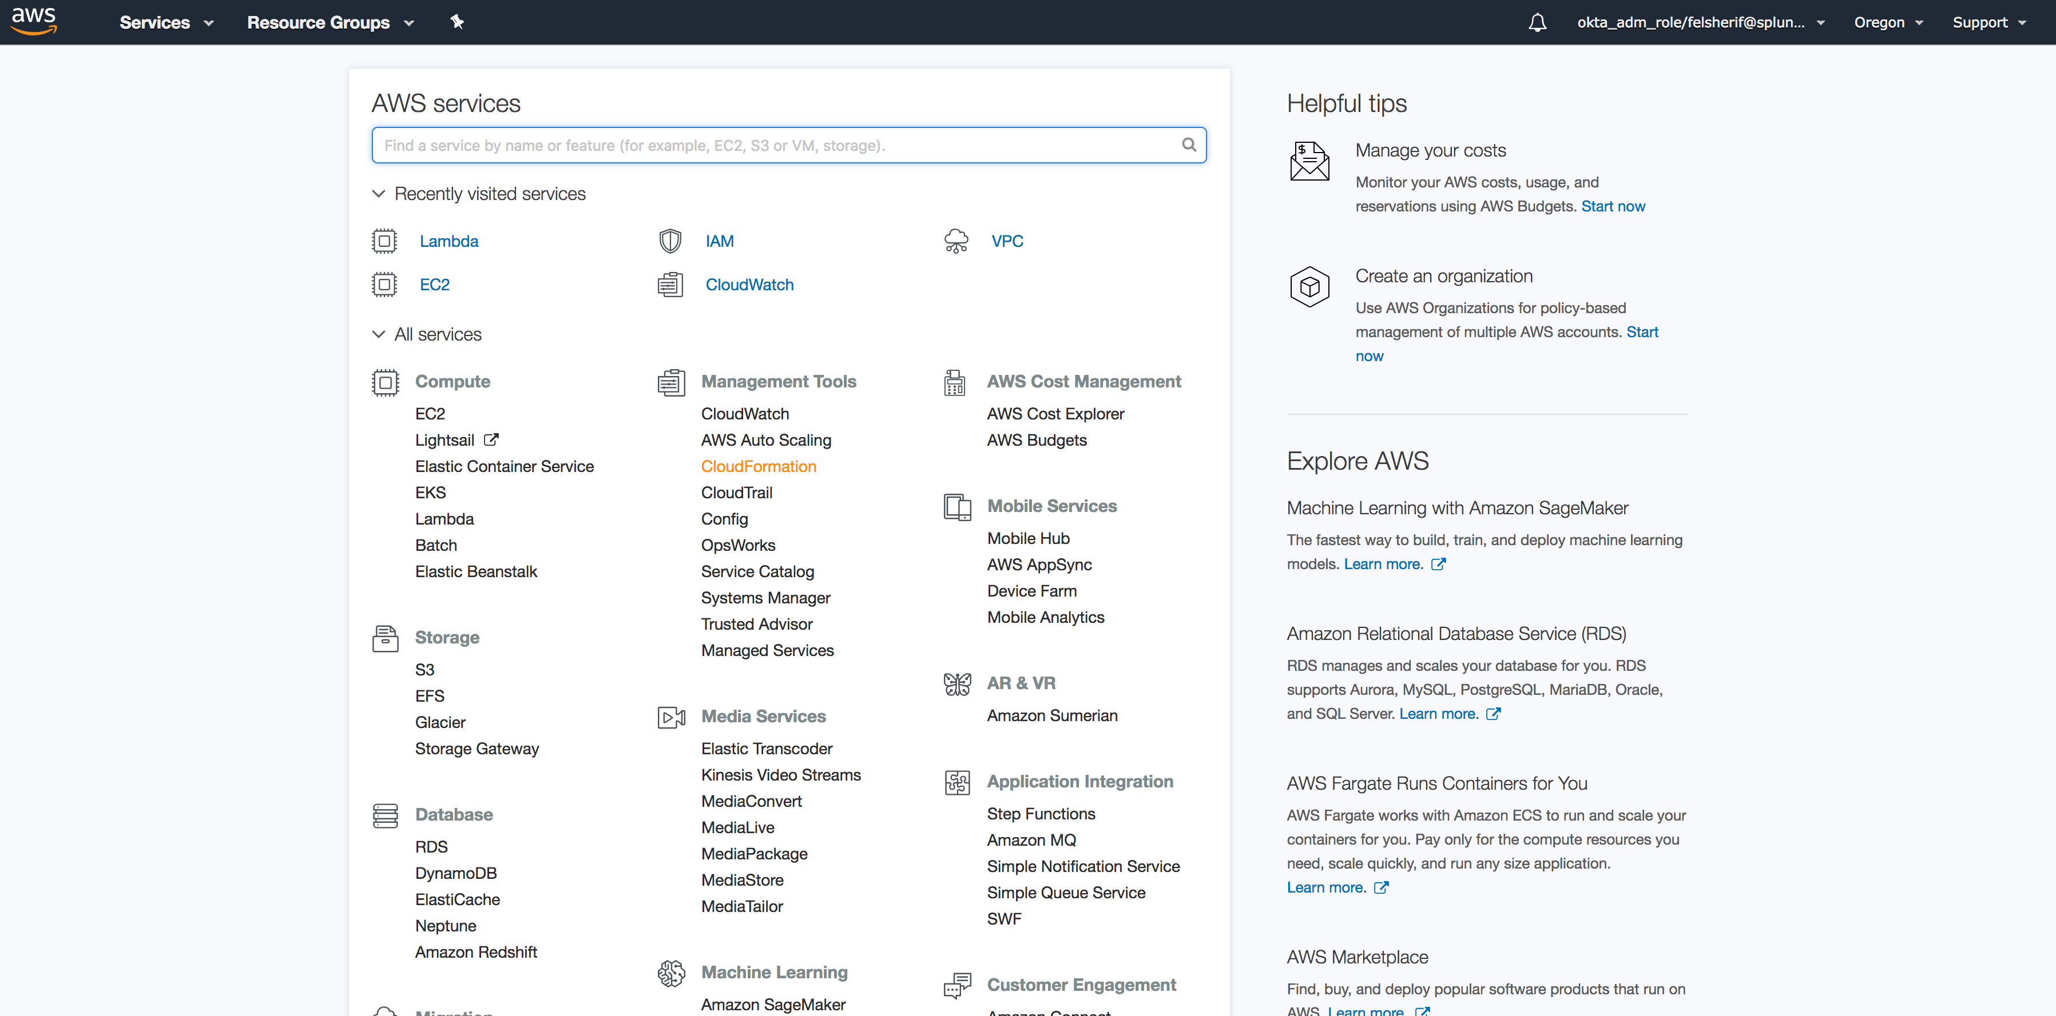
Open CloudFormation on AWS
Management Tools -> CloudFormation
Click Here

Slide 13
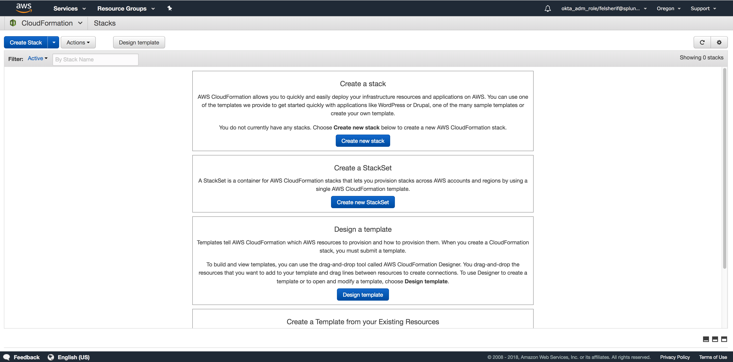
Create New Stack

Slide 14
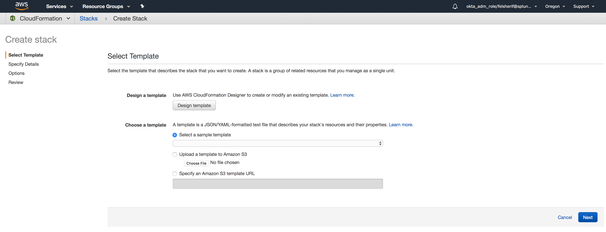
Click on Design template
Click Here

Slide 15
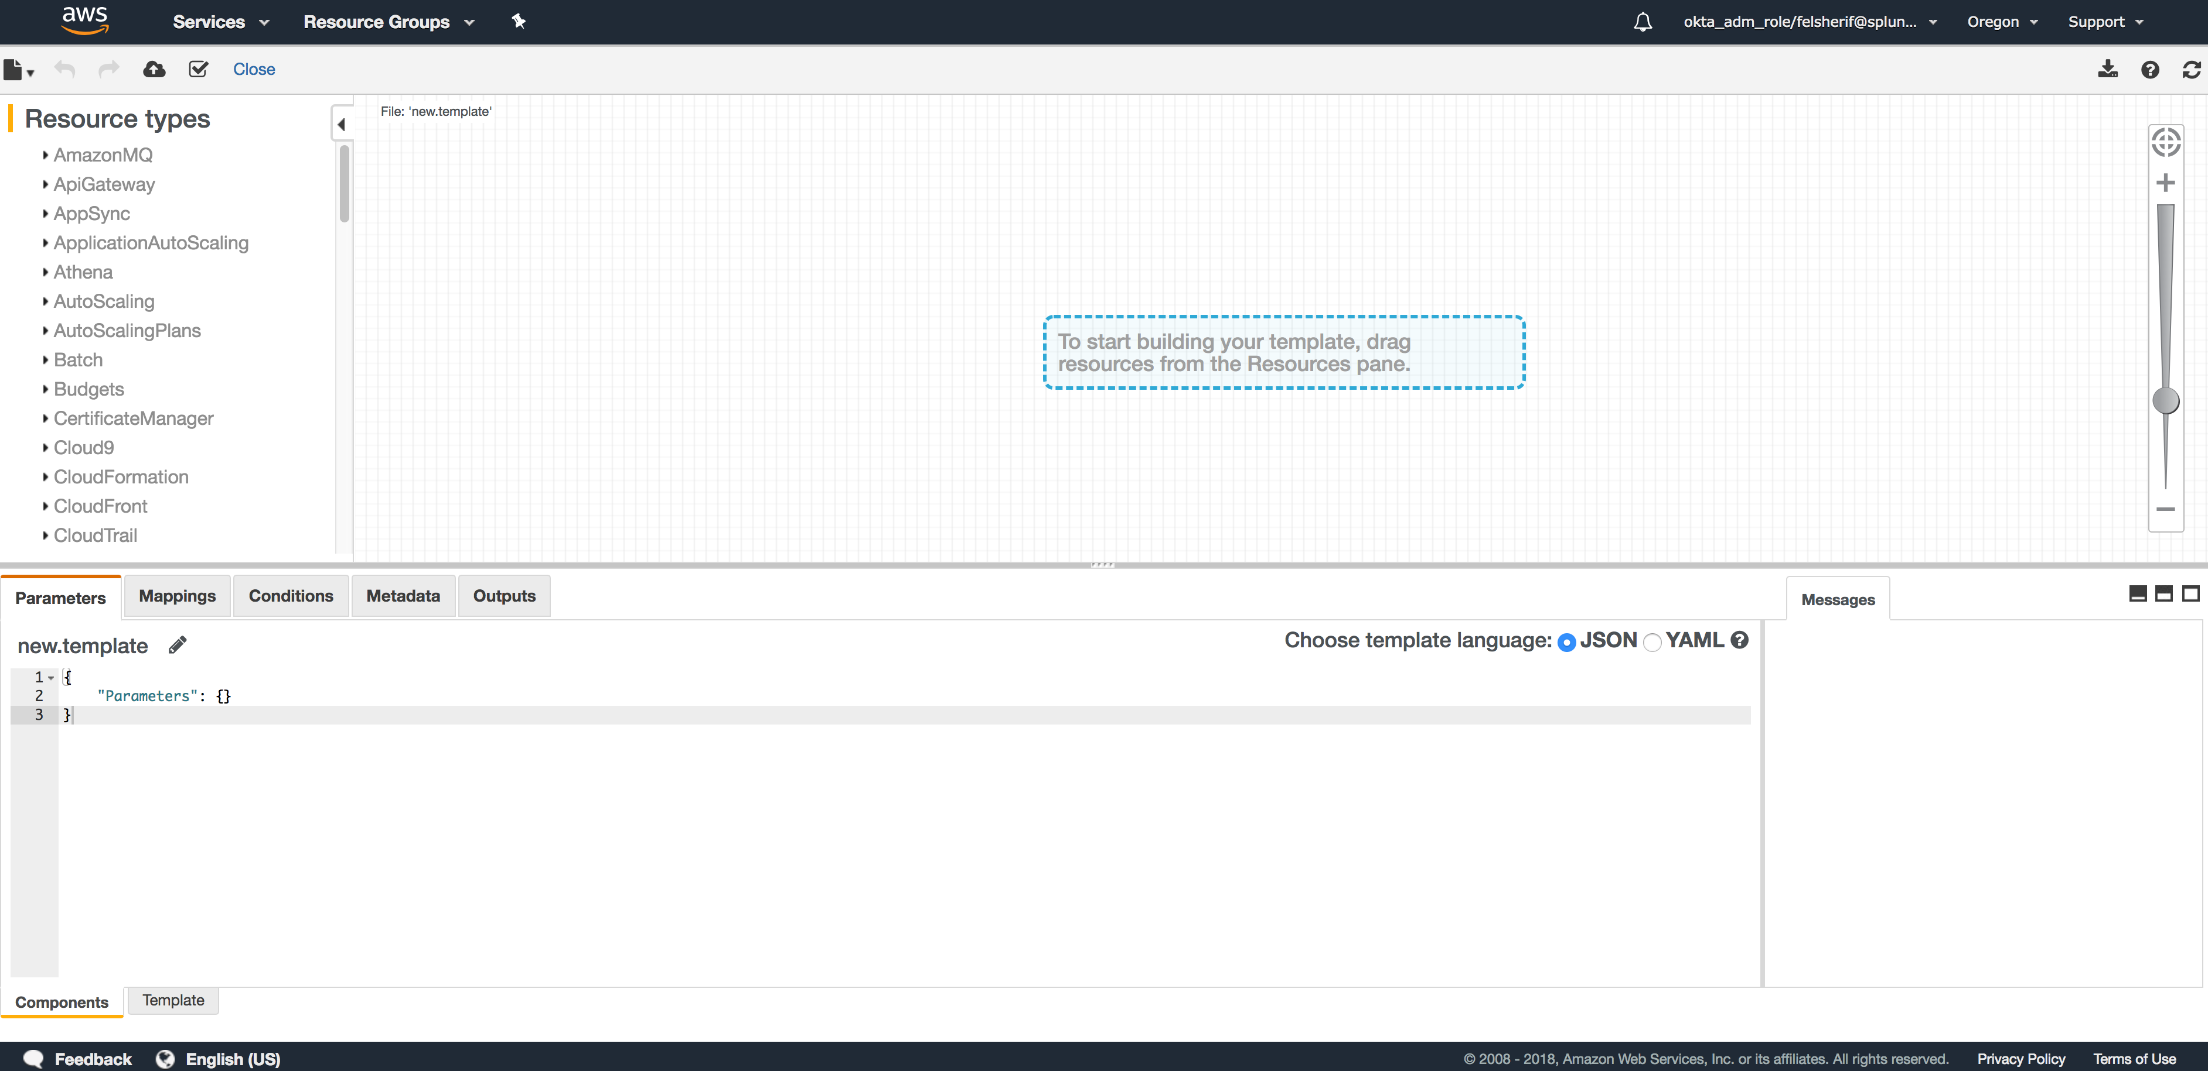
Locate the Template tab
Click Here

Slide 16
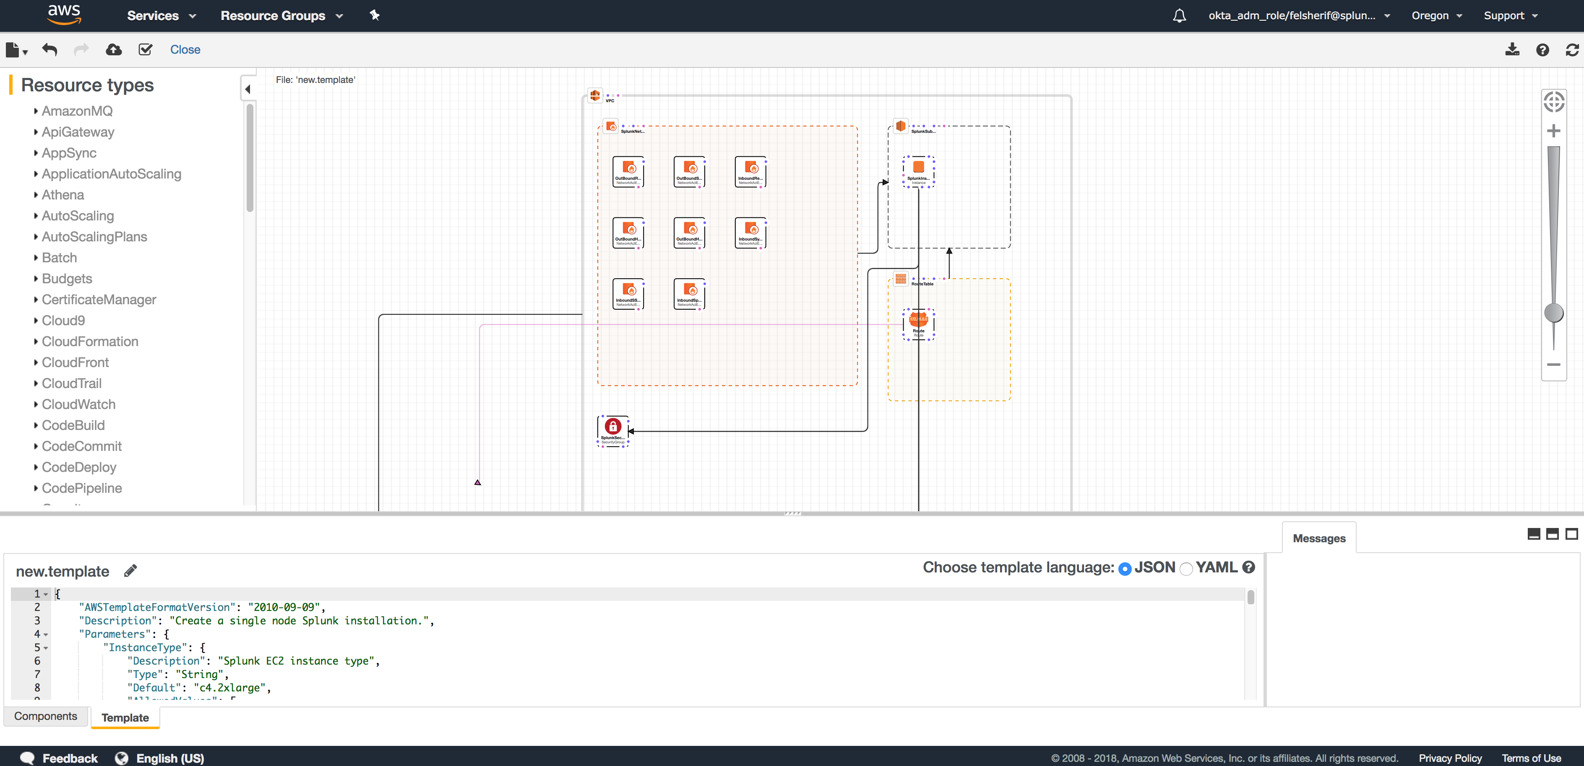
Paste JSON / Refresh
2) Click
Refresh
1) Paste JSON Here

Slide 17
Deploy CF Template
Click Here

Slide 18
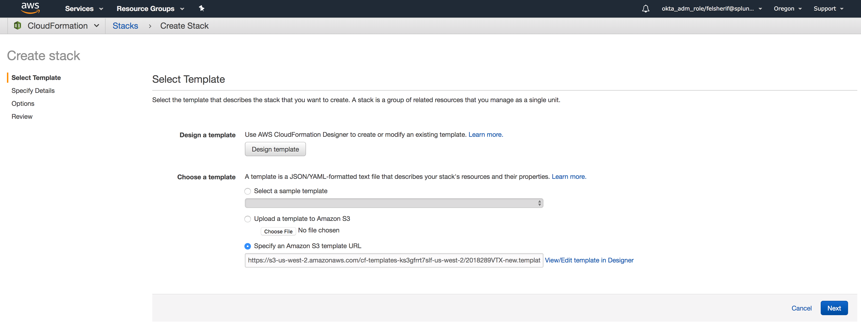
Select the template and click next

Slide 19
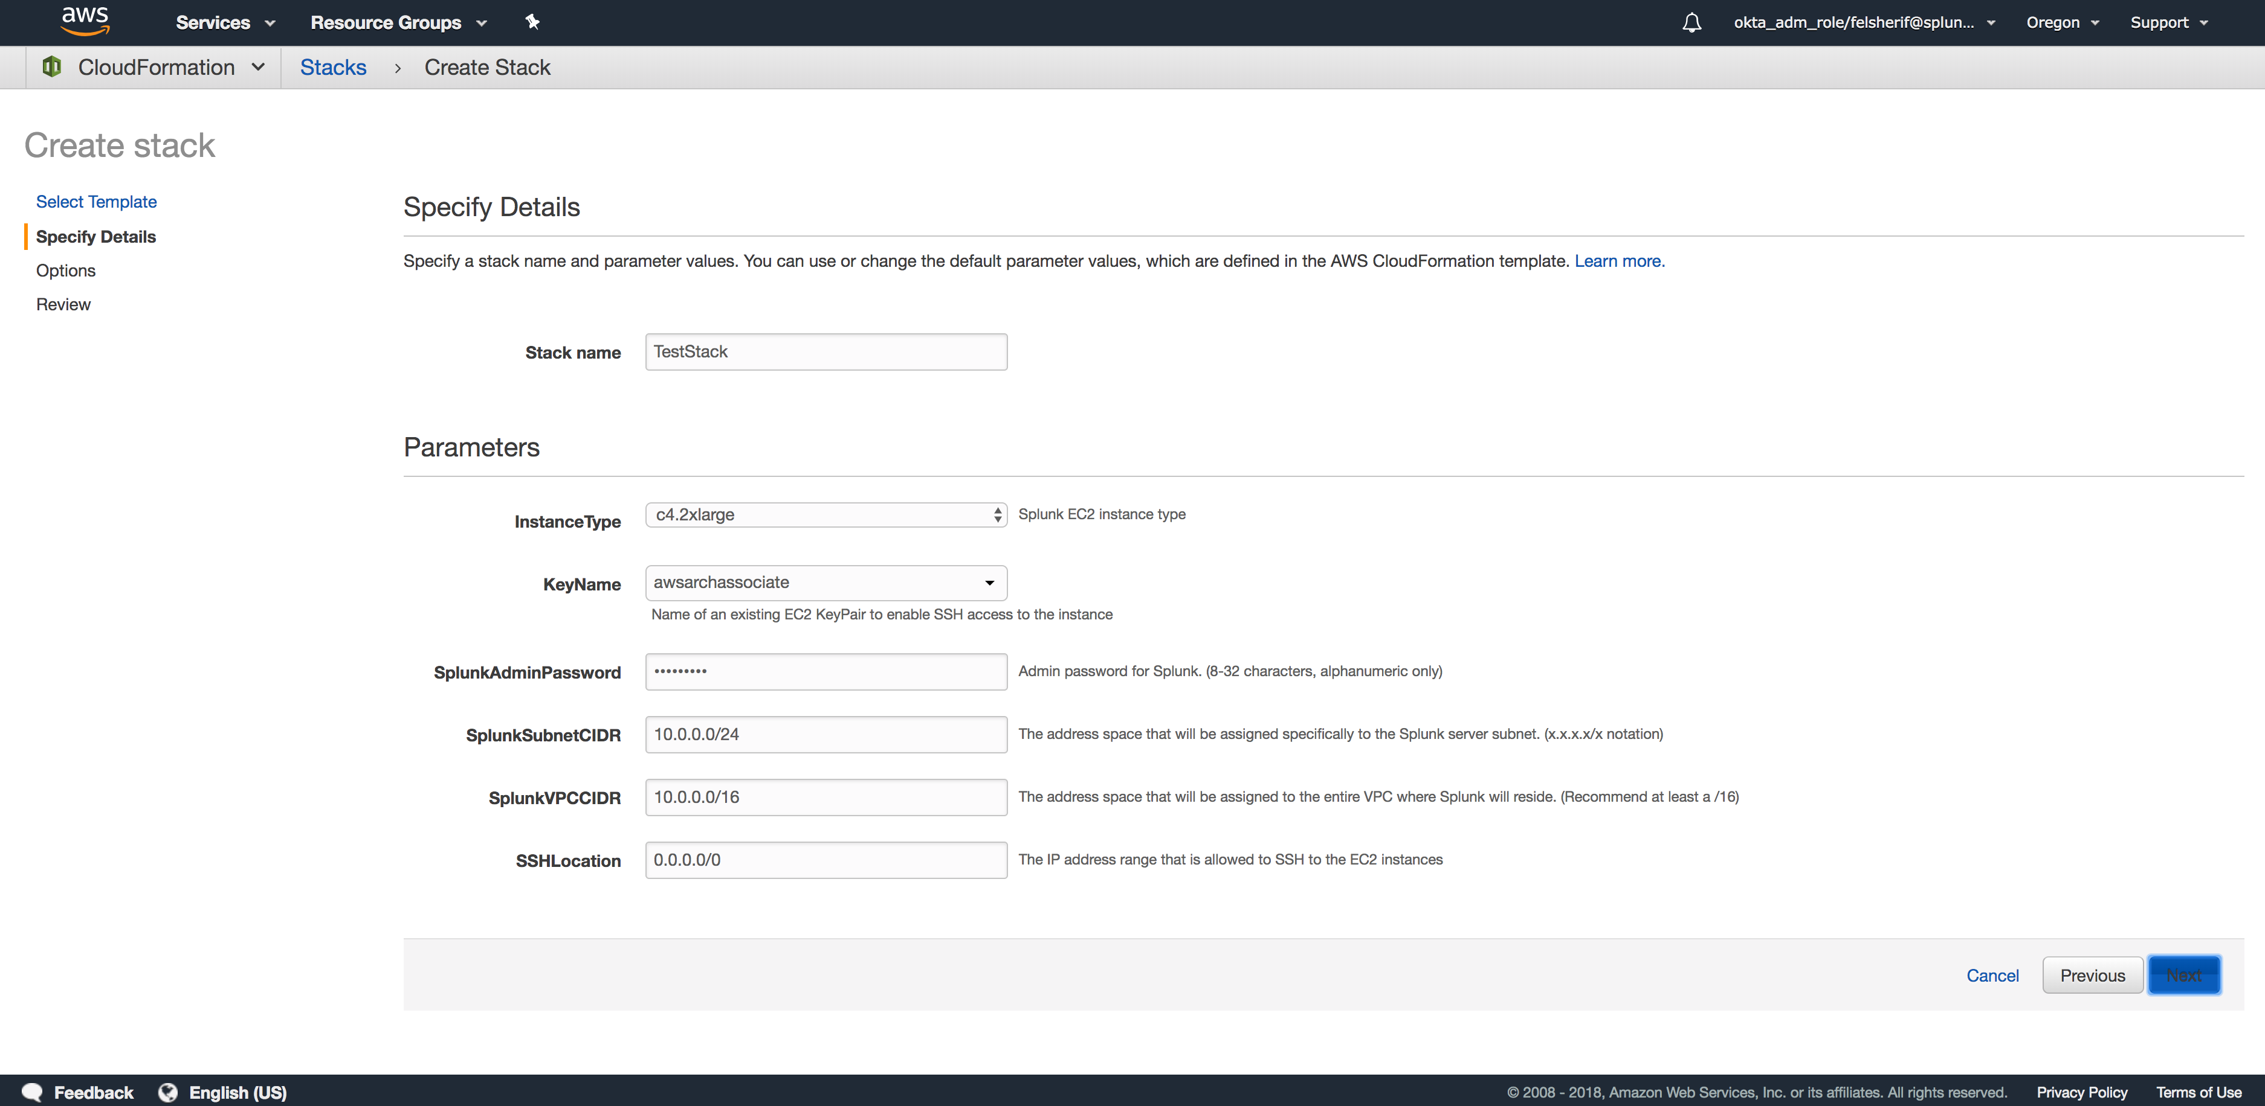
Fill out the form
Enter a “stack name”
Select a Key which you will use to SSH into the box
Change the password
Finally enter your IP or 0.0.0.0/0 to allow SSH from anywhere.

Slide 20
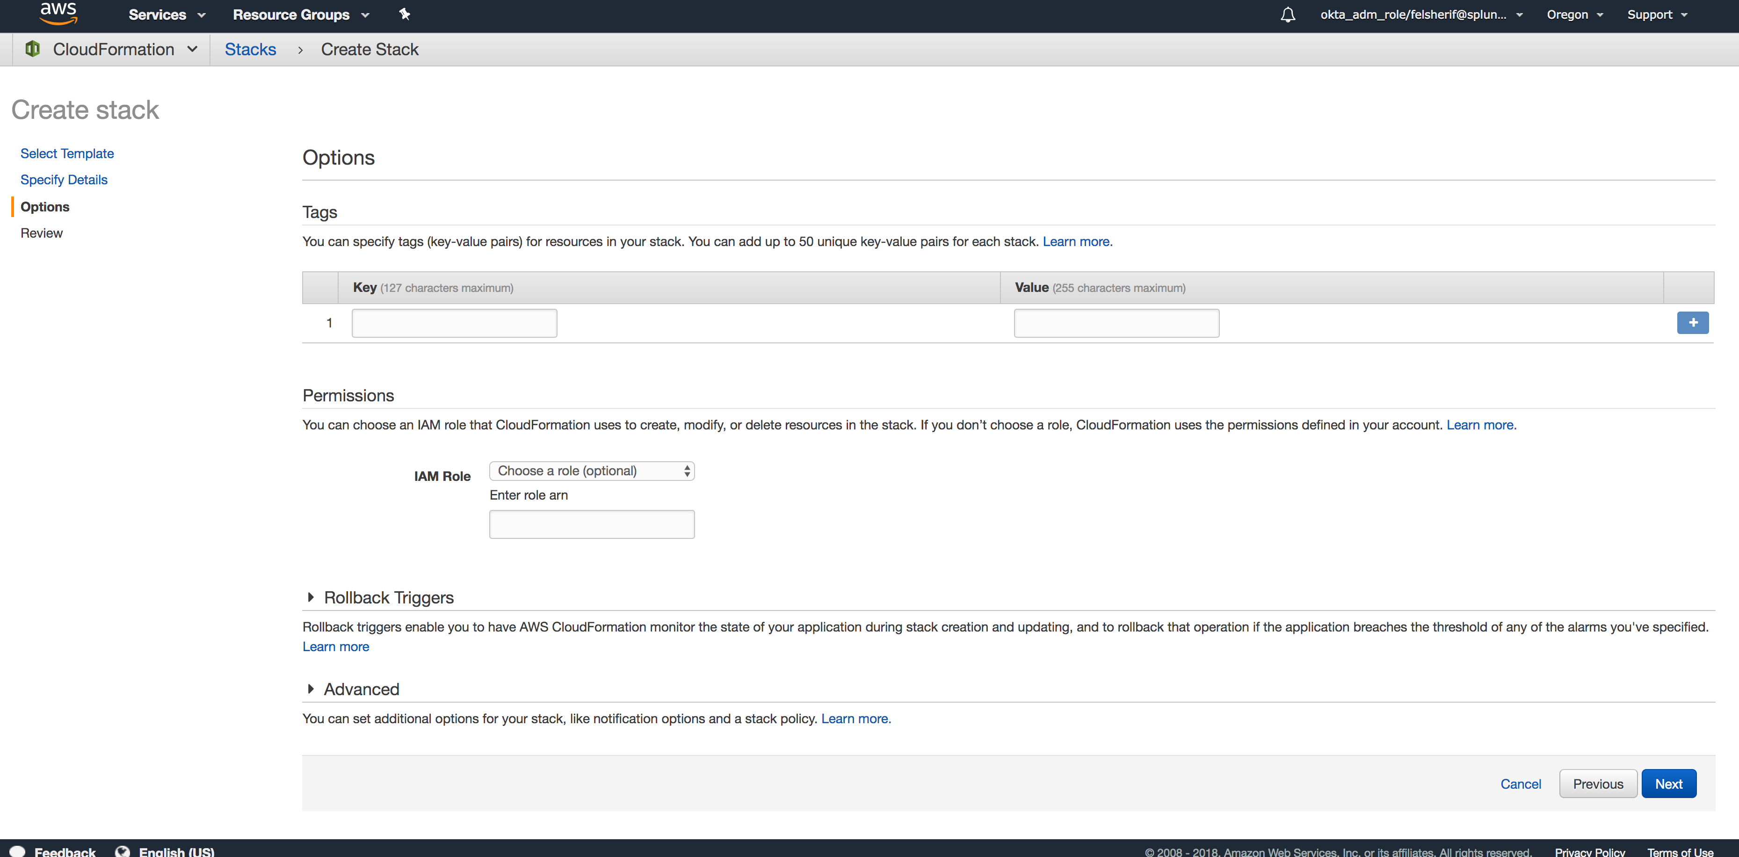
Fill out Tags / IAM Role
Add Tags or an IAM role for the EC2 instance(s).

Slide 21
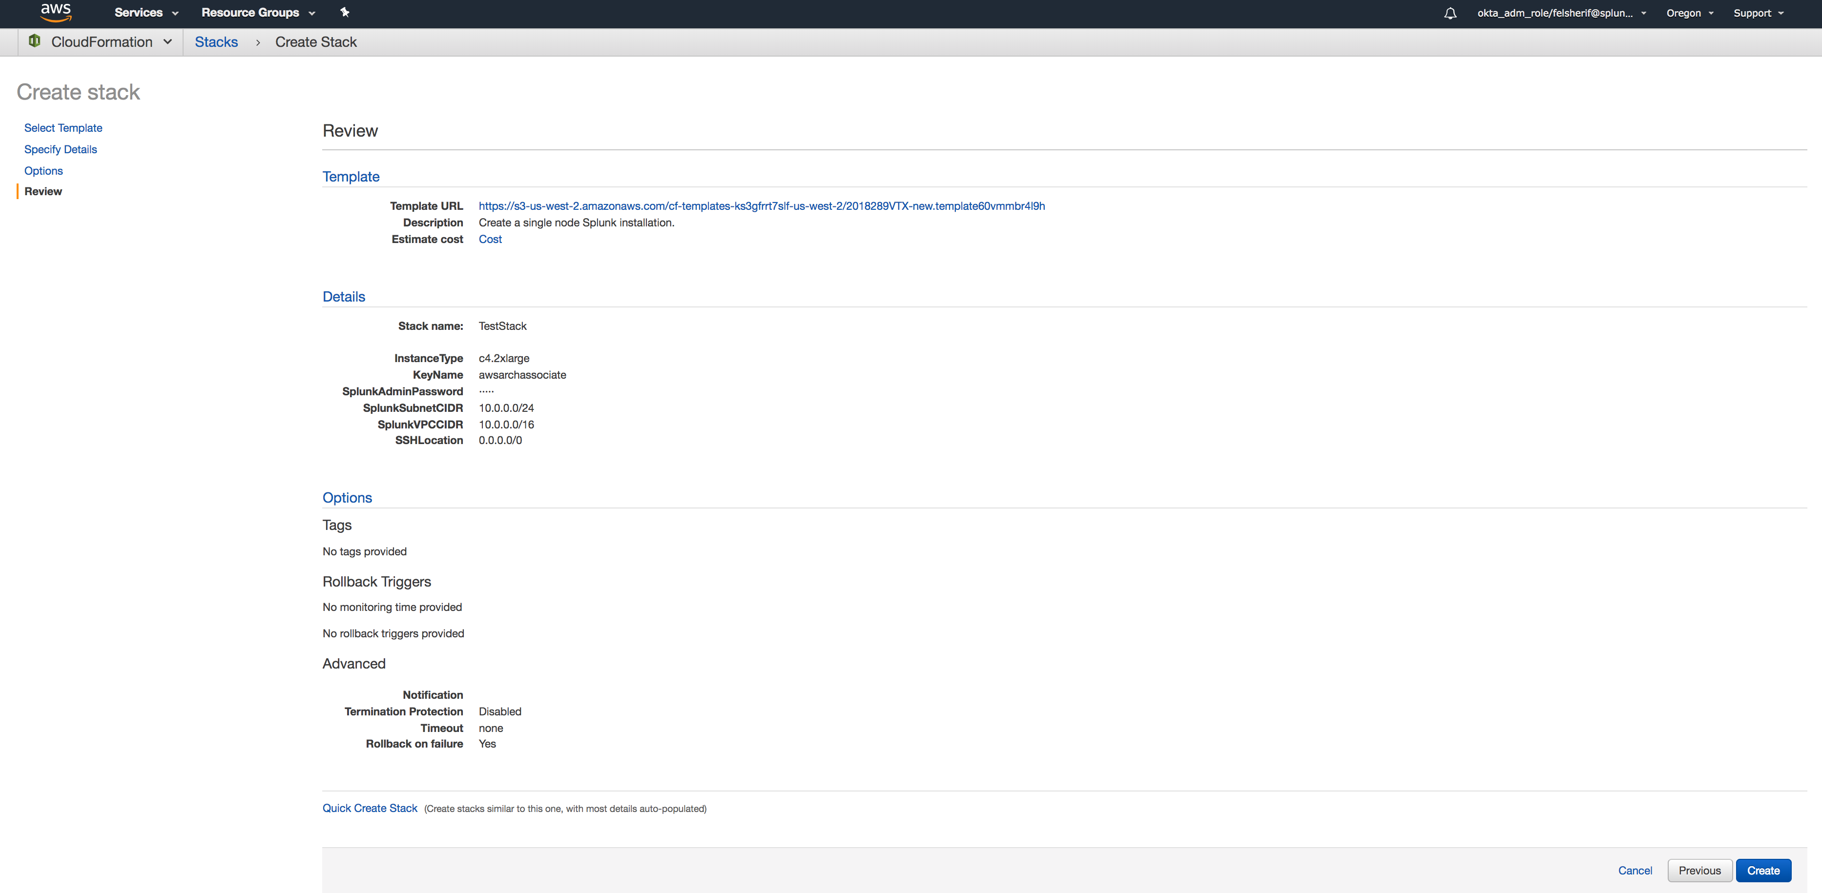
Review and Create Stack

Slide 22
Watch Stack being provisioned
Click to reload view

Slide 23
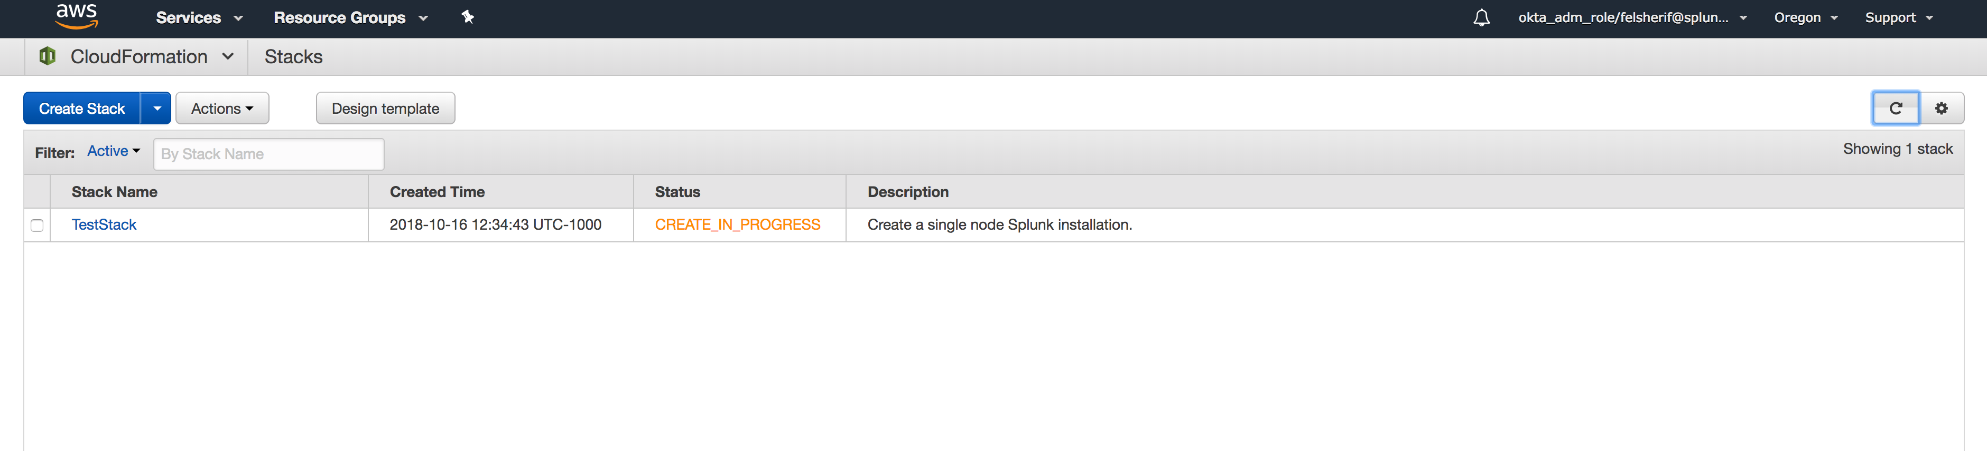
Watch Stack being provisioned
Click on the stack to get details

Slide 24
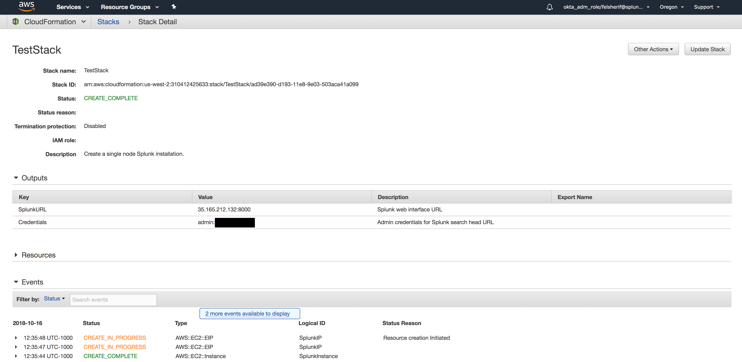
See Outputs once stack complete
Wait 10-15 minutes to make sure all post changes are made.

Slide 25
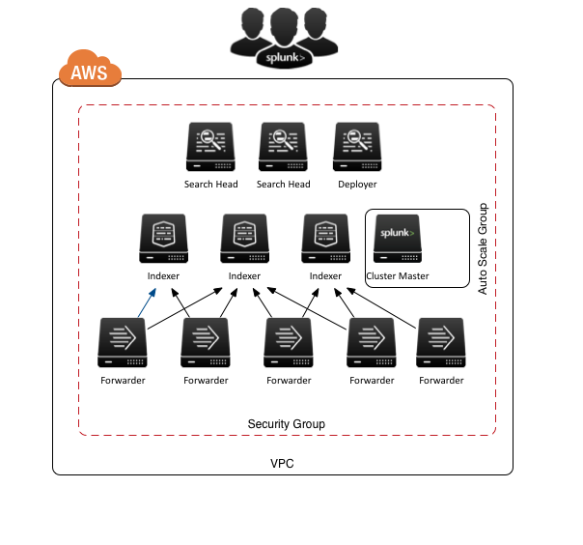
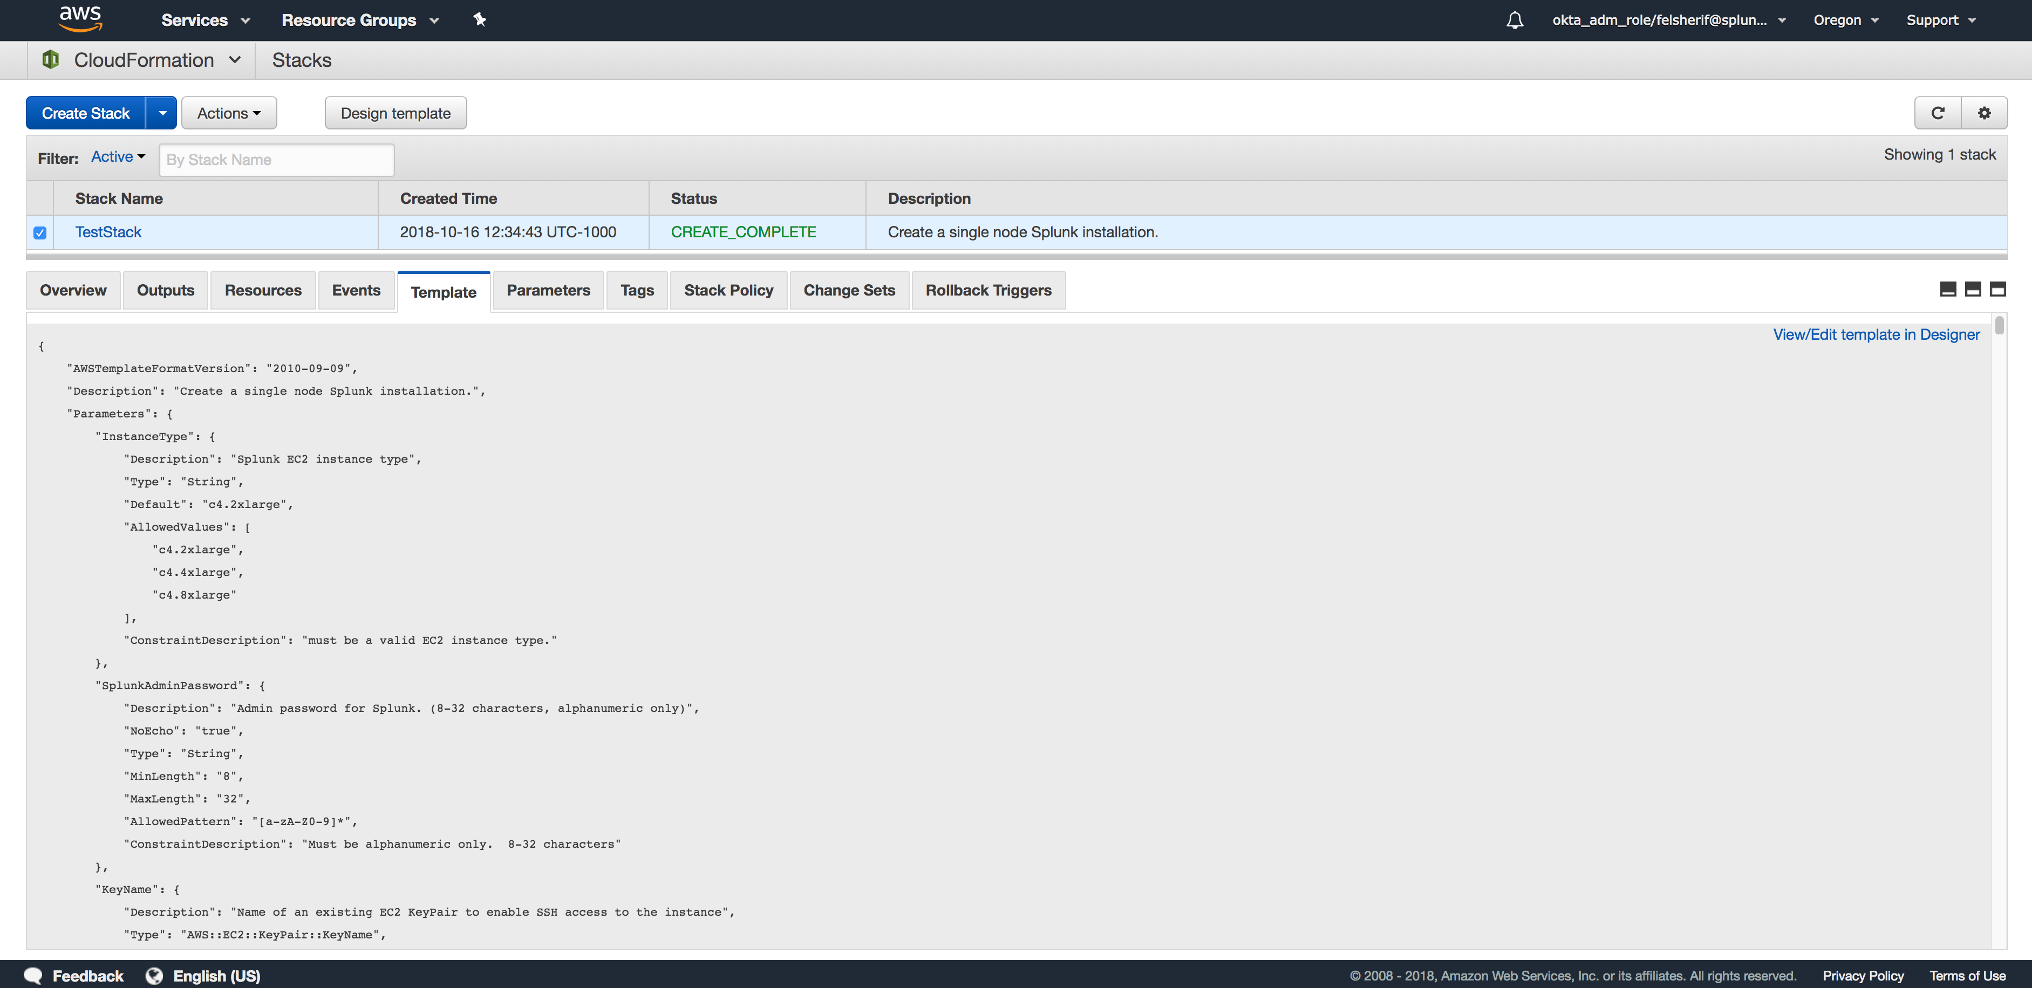
Splunk Quick Start
From code to deployment in 5 minutes
AWS CloudFormation Template
Fully Deployed Splunk Stack

Slide 26
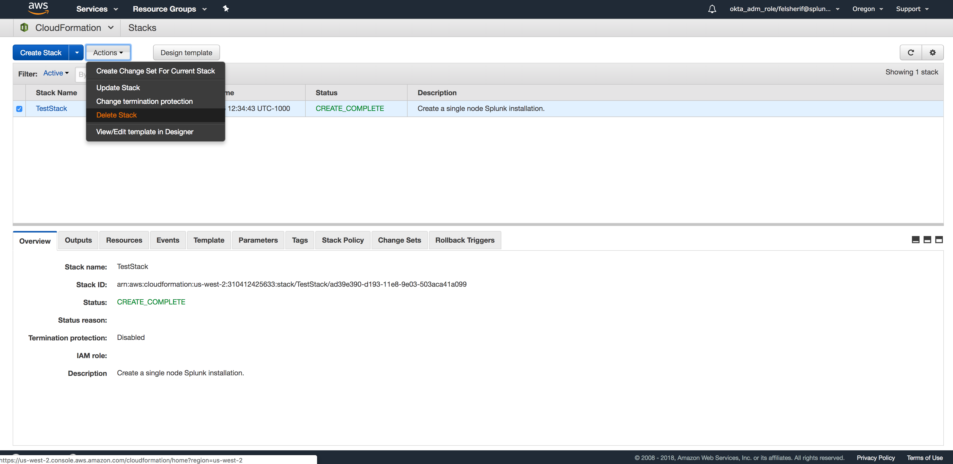
Delete Stack
Once you’re done, you can simply “Delete Stack” and it will remove all instances.

Slide 27
Continue to Module 7: Setup ELB HWF Tier

